Slide 1
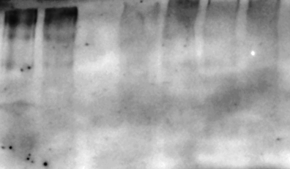
SNCA Trpl.
SNCA Trpl.
Tyr 2.5uM
DMSO
Tyr 0.3uM
Prostatin
Prostatin 5μΜ
ΤyrΑ9 0.3μΜ
ΤyrΑ9 0.3μΜ
ΤyrΑ9 2.5μΜ
Untreated
ΤyrΑ9 2.5μΜ
Untreated
α-syn (oligomeric)
α-syn (15kDa)
Vinculin
SNCA Trpl

